Slide 1
Basic Internship@Clevered AI App/ Shape Detection System
App User Manual
Author: Yash Madnani

Slide 2
Table of Contents
Acknowledgment
About me

Slide 3
Acknowledgements
A small vote of thanks for all who have helped you in this journey of App Development – My parents, My mentor and Clevered

Slide 4
About Me..
Student’s Photograph
Student’s Introduction

Slide 5
About My Internship with Clevered..
Any photographs from sessions etc.
Your internship experience with Clevered
Badges:
Project Completion
Attendance

Slide 6
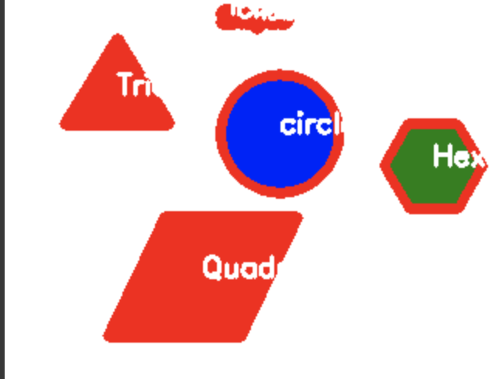
About App..
App’s Main Menu:
App’s Introduction: This app allows you to upload an image and it will identify the shapes in the image

Slide 7
How do I use the App?

Slide 8
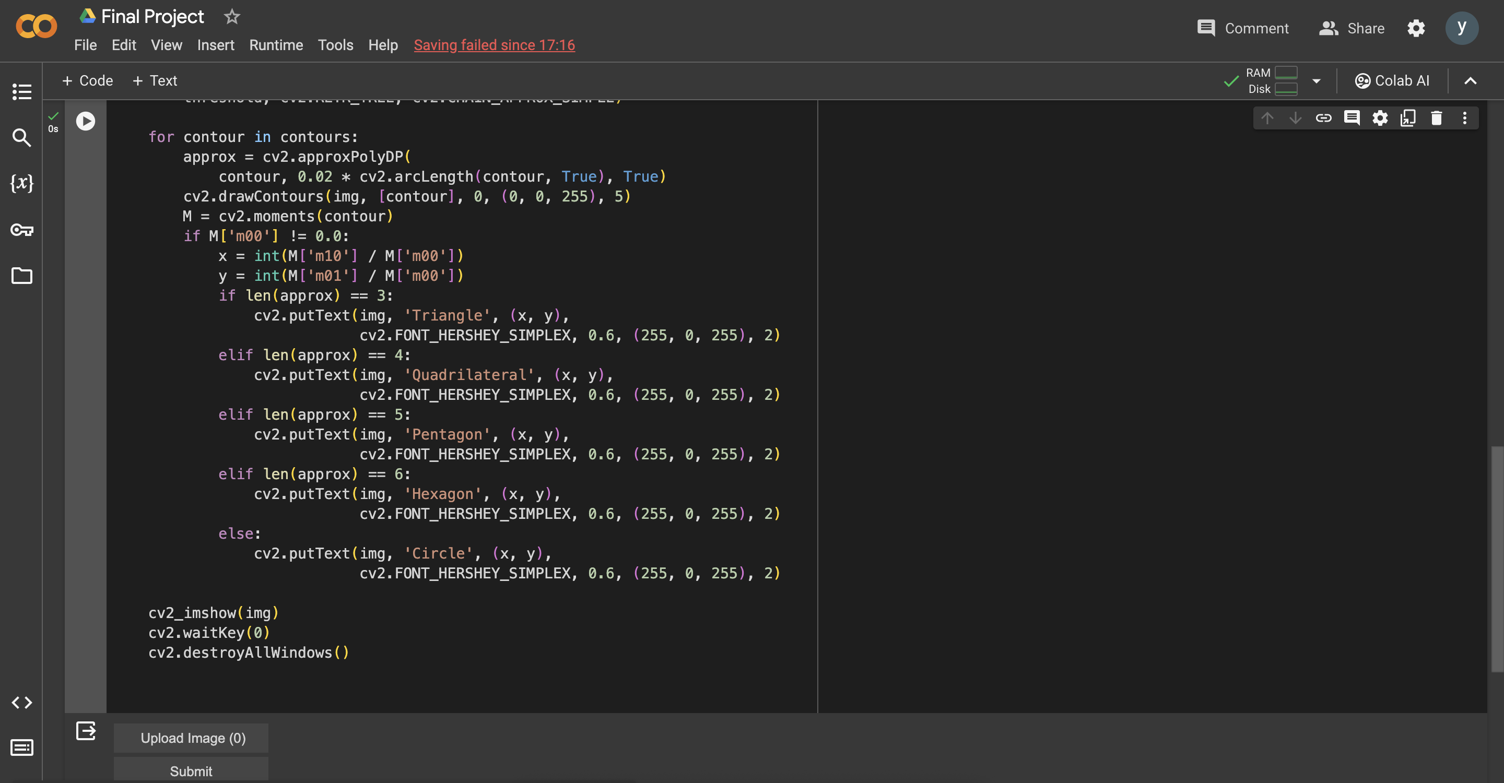
Option Name
(This will be repeated for each option of the App)
Screenshot/ Pic of each option/screen of the App
Steps to use the same
Any special considerations/ dependencies/risks while using the option

Slide 9
Contact Person
Please reach out to Yash Madnani at ymadnani2800@gmail.com for any questions/ concerns/ suggestions on the App

Slide 10
Thank you!

